Slide 1

Procesamiento de Imágenes
Domingo Mery
Departmento de Ciencia de la Computación
Escuela de Ingeniería
Universidad Católica de Chile
Semestre 2018-2
Espacios de Color
[ Capítulo 2 ]

Slide 2
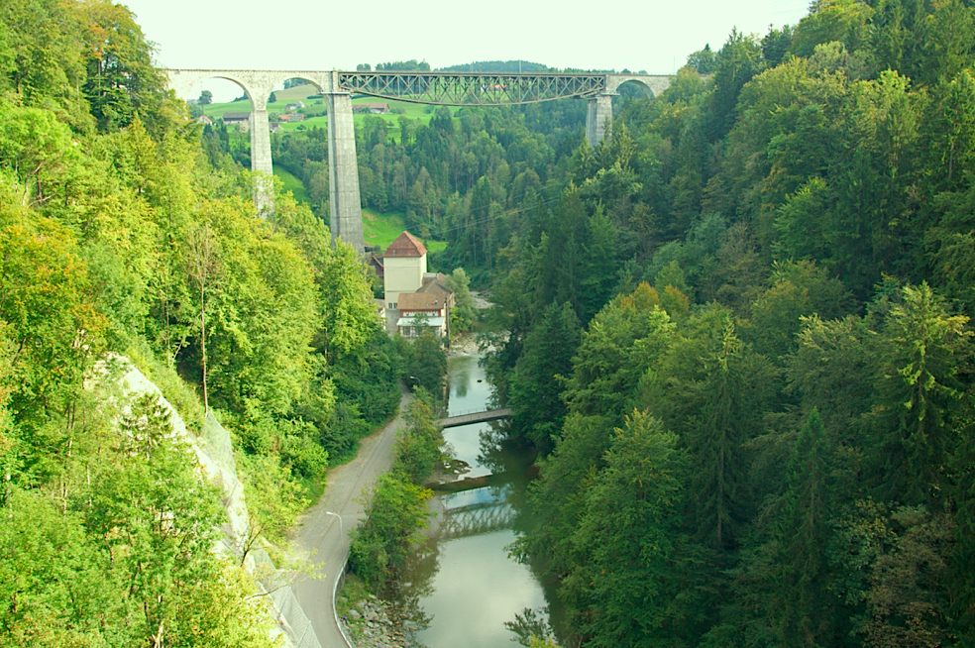

Slide 3
Notes:
Color is extremely subjective and personal. To try to attribute numbers to the brains reaction to visual stimuli is very difficult. The aim of color spaces is to aid the process of describing color, either between people or between machines or programs. http://biology.duke.edu/johnsenlab/pdfs/tech/colorconversion.pdf

Slide 4
The aim of color spaces is to aid the process of describing color, either between people or between machines or programs.
Notes:
Color is extremely subjective and personal. To try to attribute numbers to the brains reaction to visual stimuli is very difficult. The aim of color spaces is to aid the process of describing color, either between people or between machines or programs. http://biology.duke.edu/johnsenlab/pdfs/tech/colorconversion.pdf

Slide 5
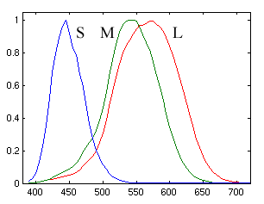
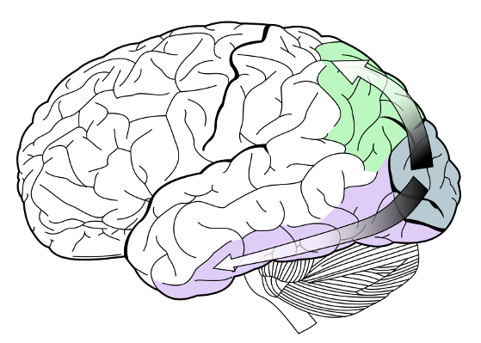
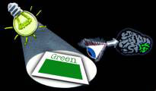
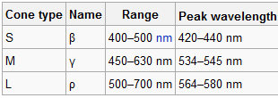
[ Color perception ]
Notes:
Color is the brains reaction to a specific visual stimulus. Although we can precisely describe color by measuring its spectral power distribution (the intensity of the visible electro-magnetic radiation at many discrete wavelengths) this leads to a large degree of redundancy. The reason for this redundancy is that the eye’s retina samples color using only three broad bands, roughly corresponding to red, green and blue light. The signals from these color sensitive cells (cones), together with those from the rods (sensitive to intensity only), are combined in the brain to give several different “sensations” of the color. http://biology.duke.edu/johnsenlab/pdfs/tech/colorconversion.pdf

Slide 6
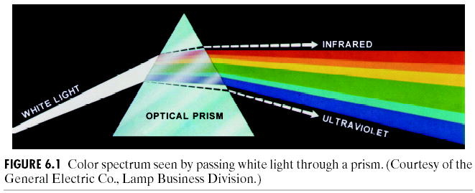
[ Optical prism ]

Slide 7
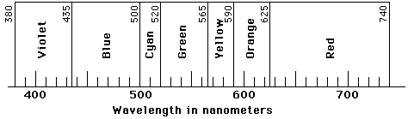
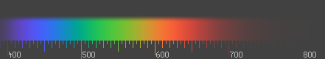
[ Color definition ]
wavelength [nm]

Slide 8
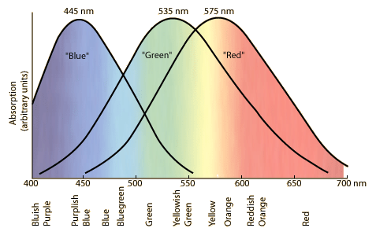
[ Human eye response ]
Notes:
The tri-chromatic theory describes the way three separate lights, red, green and blue, can match any visible colour – based on the eye’s use of three colour sensitive sensors. This is the basis on which photography and printing operate, using three different coloured dyes to reproduce colour in a scene. It is also the way that most computer colour spaces operate, using three parameters to define a colour.

Slide 9
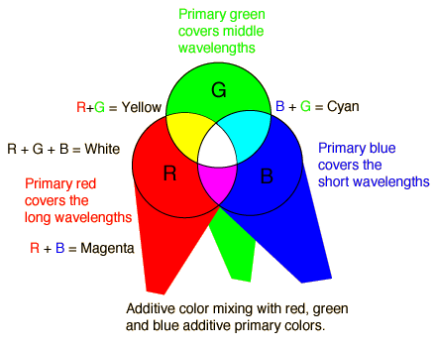
[ Aditive color mixing ]

Slide 10

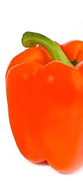
[ Substractive color mixing ]
The color that a surface displays depends on which parts of the visible spectrum are not absorbed and therefore remain visible
XXXXXX XXXXXXXXX
White light
(all colors)

Slide 11
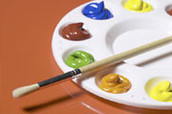
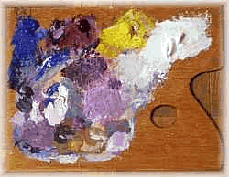
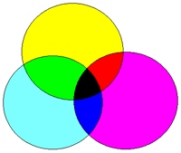
[ Substractive color mixing ]
The objects subtract wavelengths from the light, giving it color

Slide 12
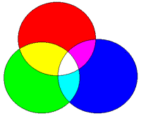
[ Color Mixing ]
Additive
Primary colors: RGB
Substractive
Primary colors:YMC, YMCK, RYB

Slide 13
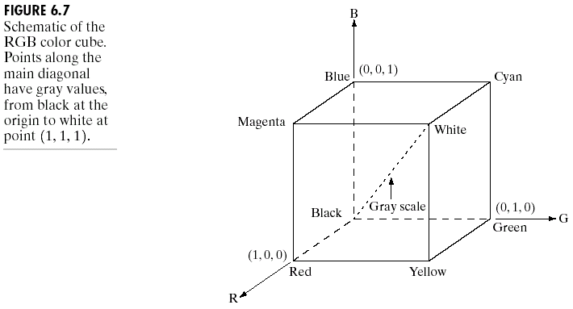
[ Color Space RGB ]
R. Gonzalez, R. Woods, S. Eddins (2009): Digital Image Processing Using MATLAB, 2nd edition. Gatesmark Publishing.

Slide 14
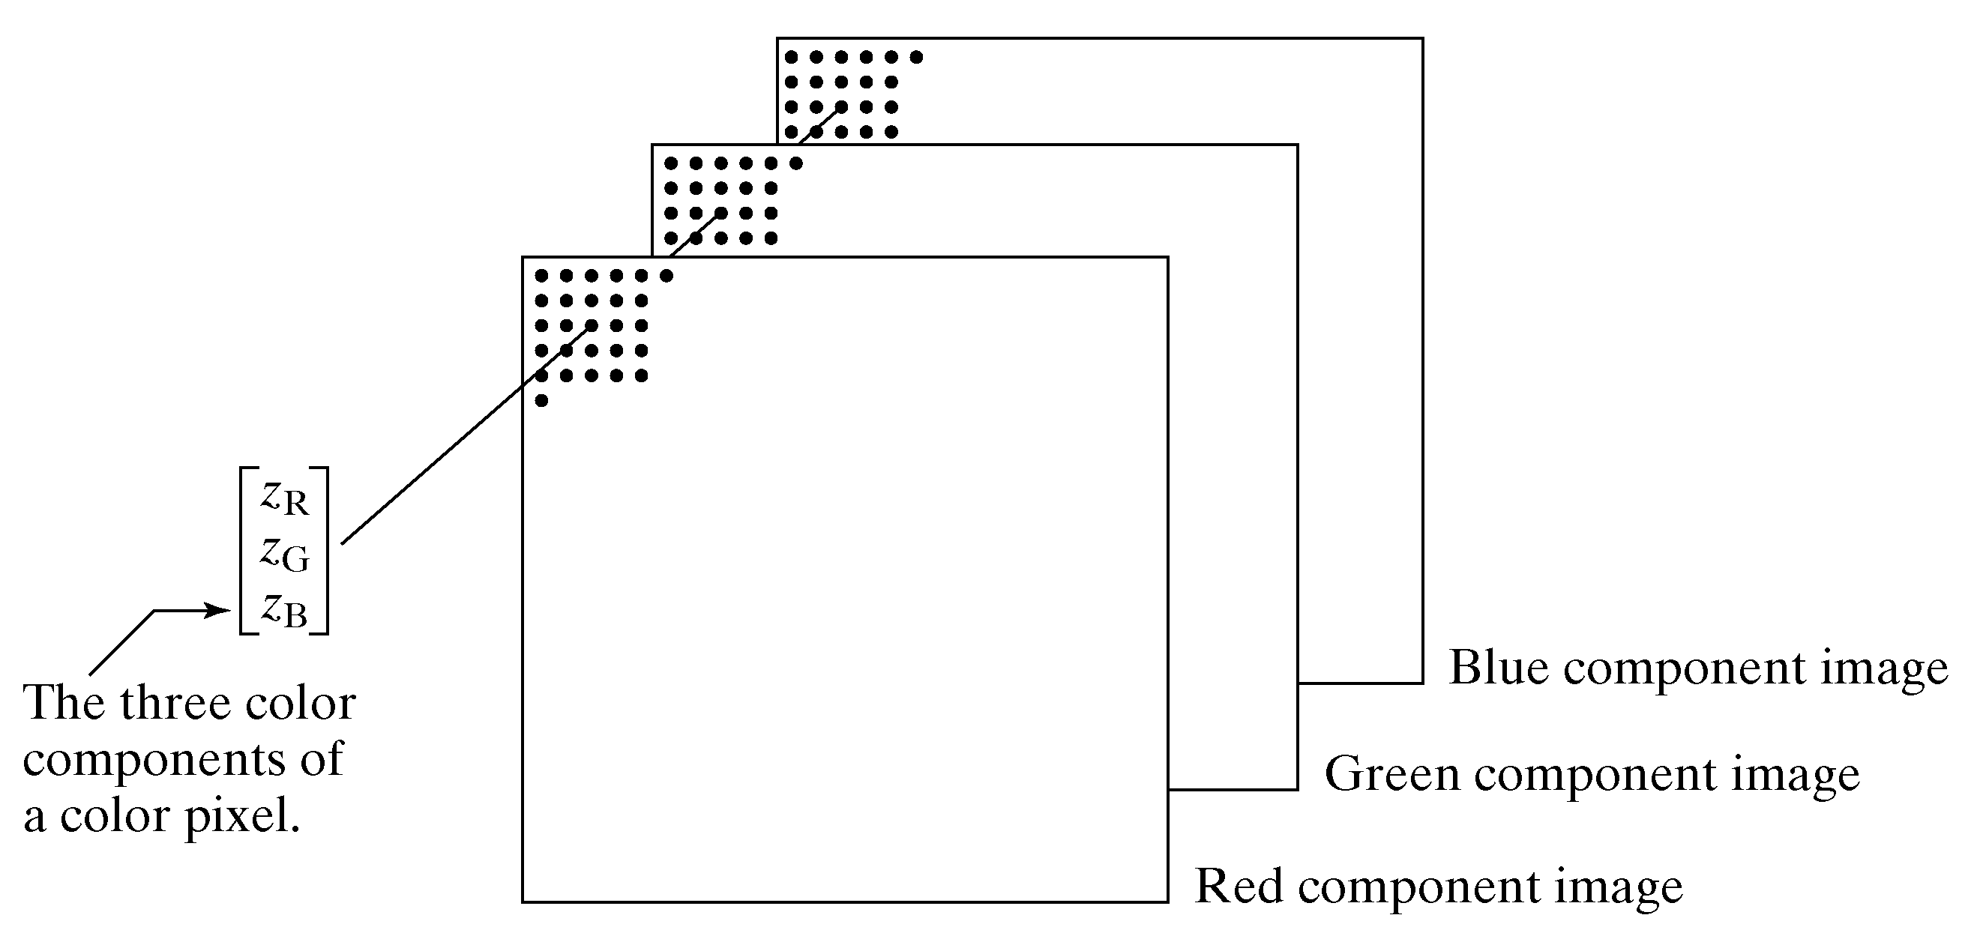
[ Digital Color Image ]
R. Gonzalez, R. Woods, S. Eddins (2009): Digital Image Processing Using MATLAB, 2nd edition. Gatesmark Publishing.

Slide 15
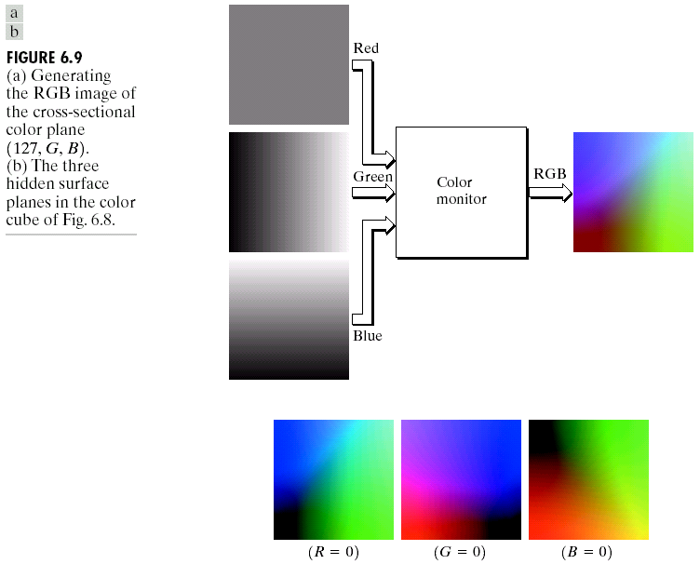
[ Color Space RGB ]
R. Gonzalez, R. Woods, S. Eddins (2009): Digital Image Processing Using MATLAB, 2nd edition. Gatesmark Publishing.

Slide 16
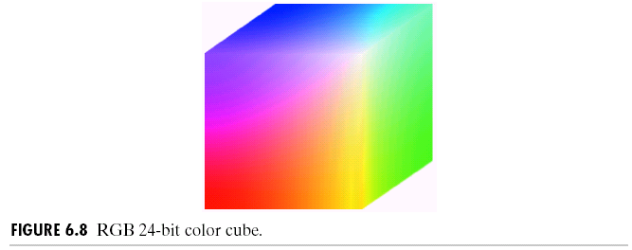
[ Color Space RGB ]

Slide 17

[ Color Space HSV ]

Slide 18
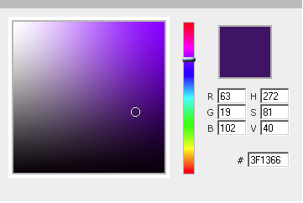
[ Color Space HSV ]
Color Picker Tool:
http://www.dynamicdrive.com/dynamicindex11/yuicolorpicker/index.htm
H
V
S

Slide 19
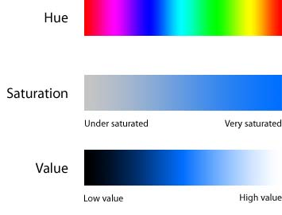
[ Color Space HSV ]

Slide 20
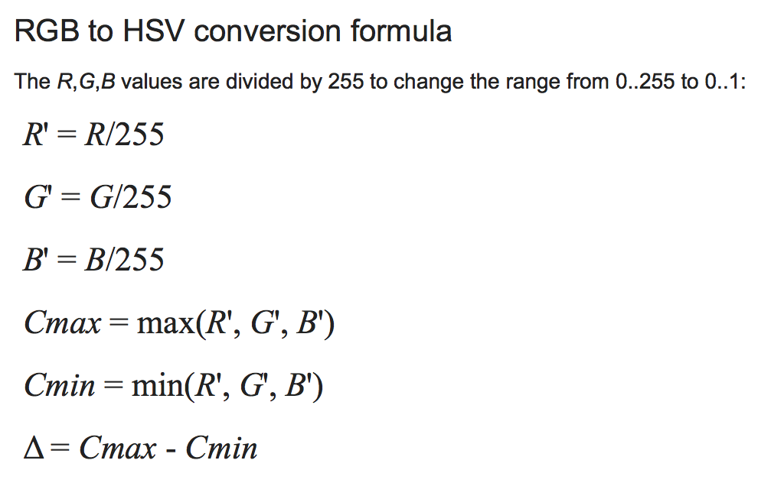
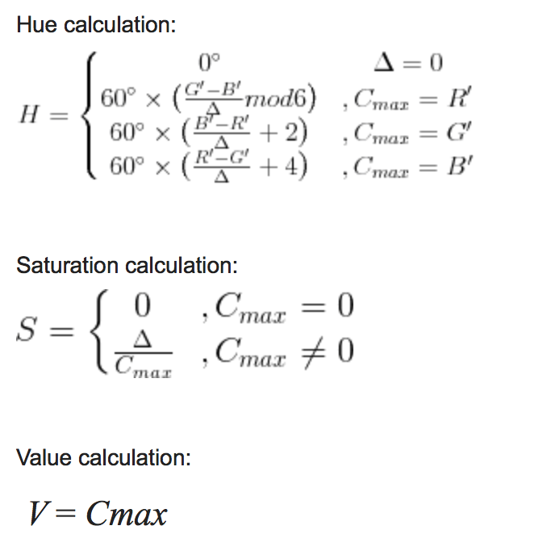
[ Color Space HSV – Conversion RGB to HSV ]

Slide 21
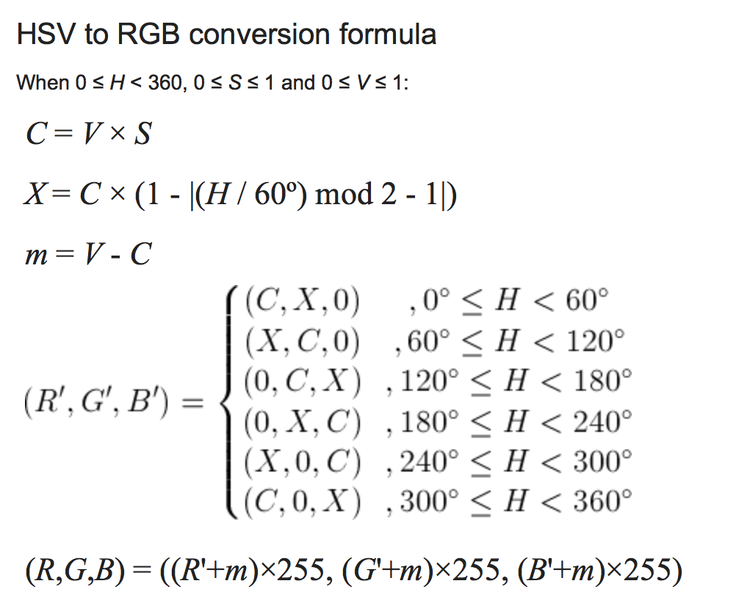
[ Color Space HSV – Conversion HSV to RGB ]

Slide 22
[ Lightroom Demo ]

Slide 23
[ How to enhance a color image ]
Take a color image
Convert RGB to HSV
Equalization of V channel only
Convert the new HSV to RGB
That’s all folk

Slide 24
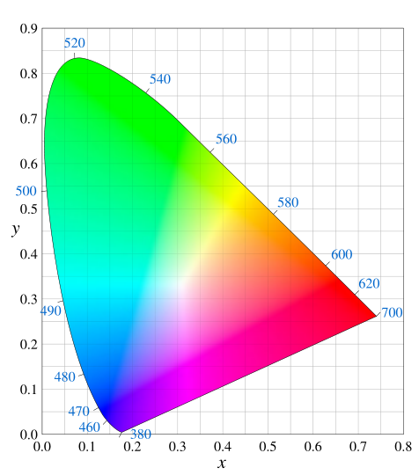
[ CIE xy – diagram ]

Slide 25
[ CIE xy – diagram ]
Possible colors using aditive mixing
Source 1
Source 2

Slide 26
[ Diagrama CIE xy ]
Possible colors using aditive mixing
Source 1
Source 2
Source 3

Slide 27
[ Diagrama CIE xy ]
Hue

Slide 28
[ Diagrama CIE xy ]
Saturation

Slide 29
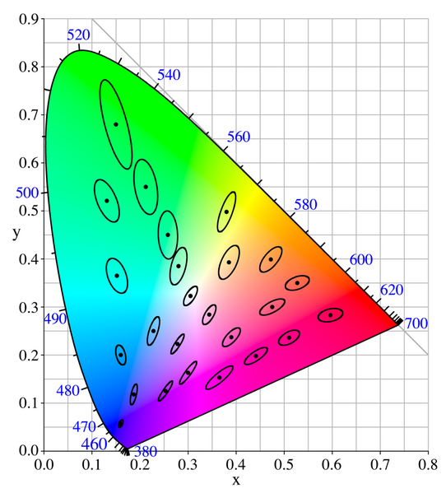
[ Similar colors: Elipsses of MacAdam ]

Slide 30
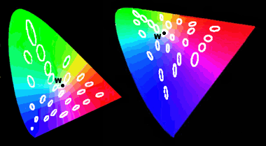
[ Diagram CIE xy vs CIE u’v’: Elipsses of MacAdam ]

Slide 31

[ Diagram CIE RGB ]

Slide 32
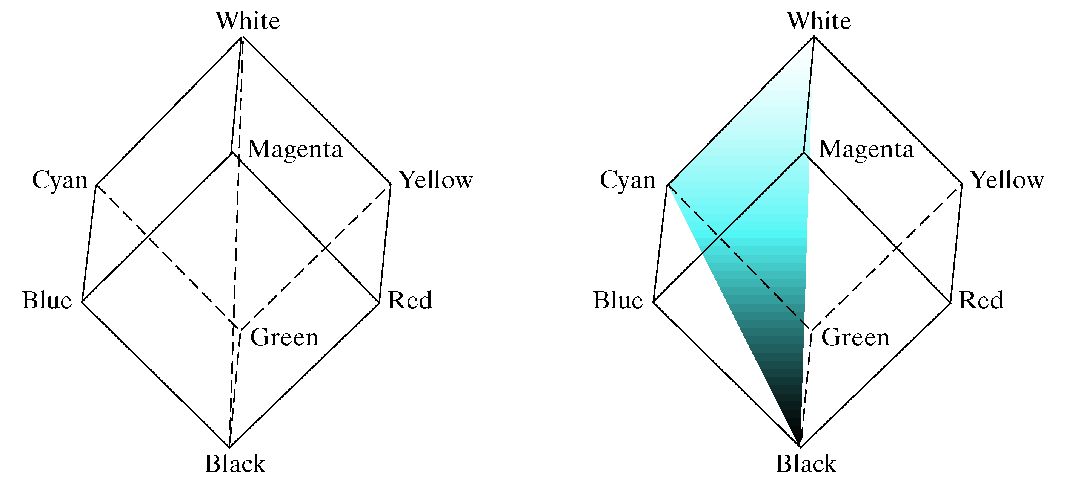
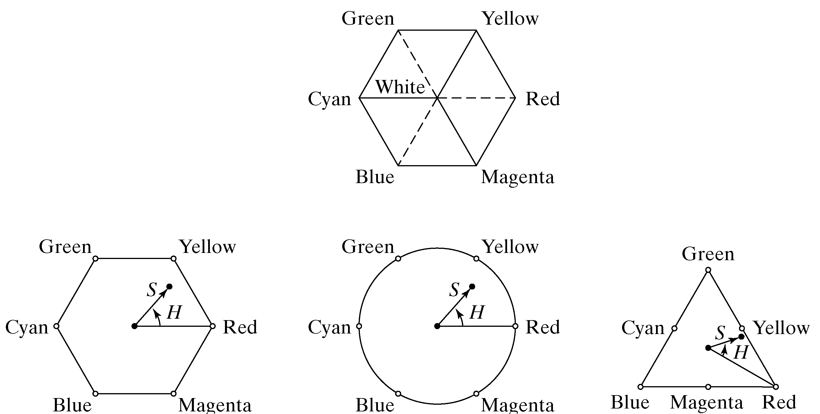
[ Color Space HSI ]

Slide 33
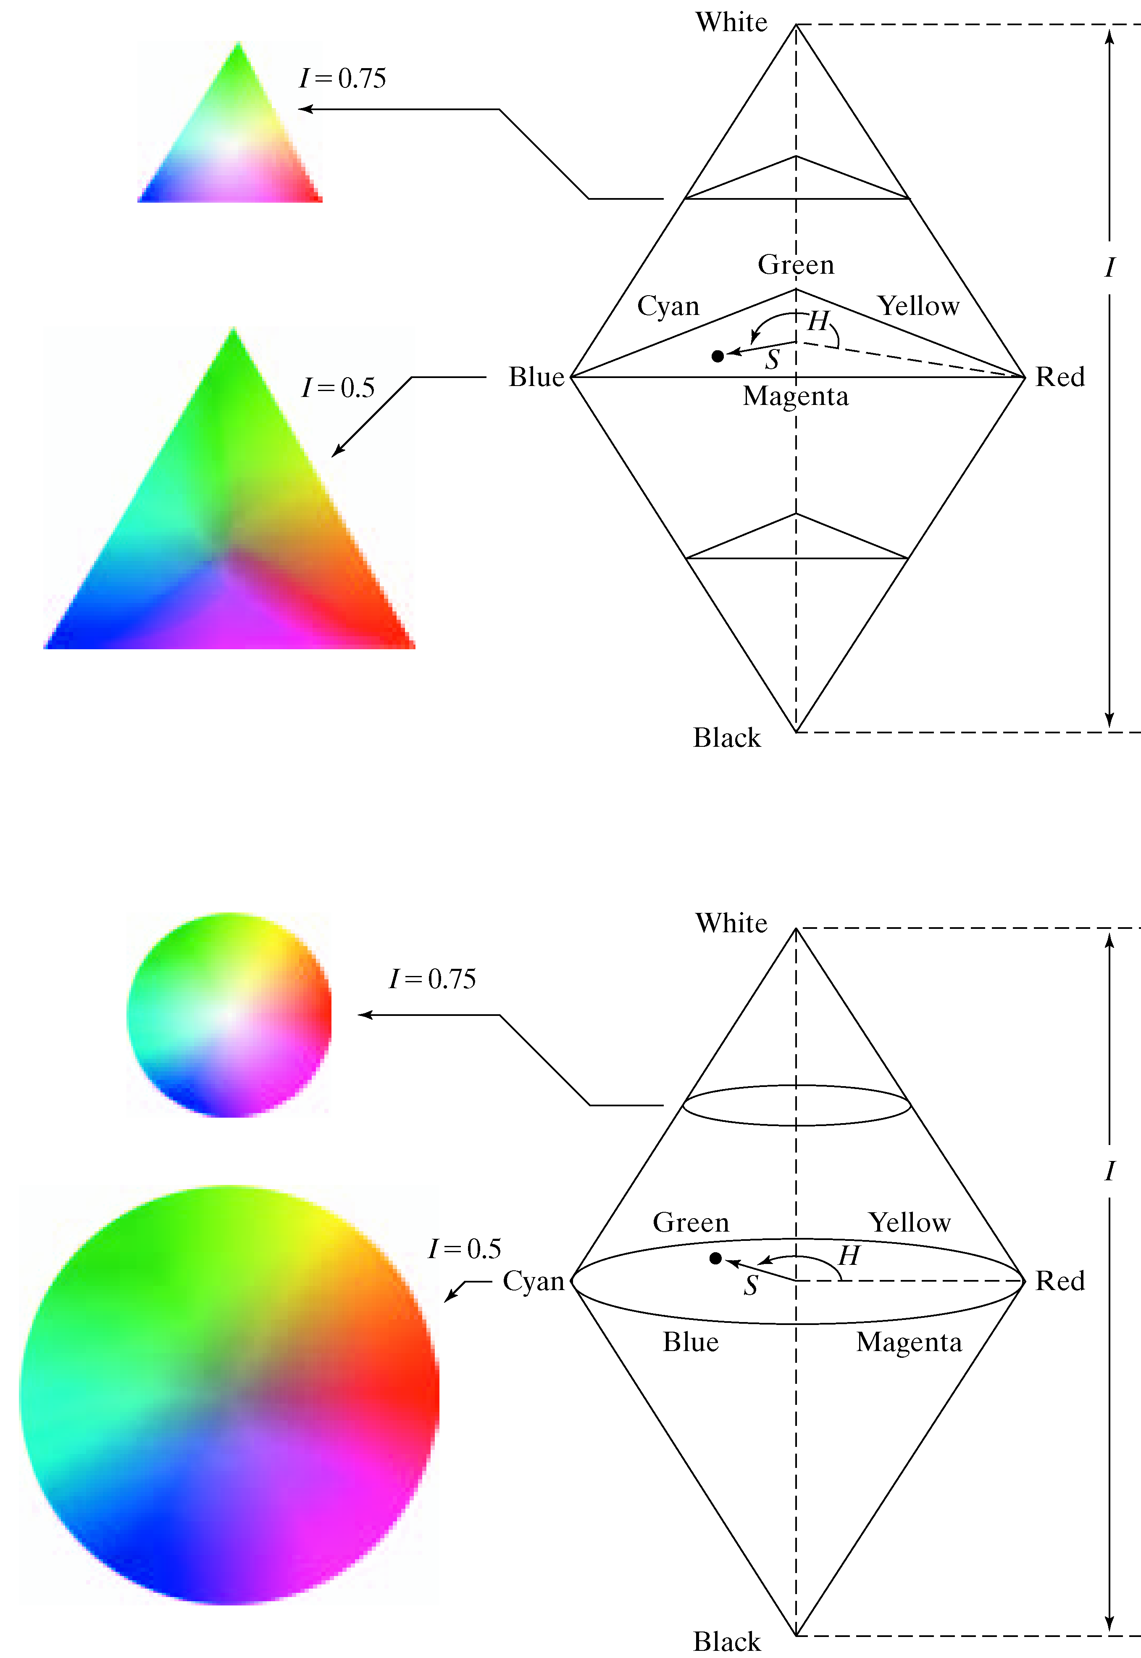
[ Color Space HSI ]

Slide 34
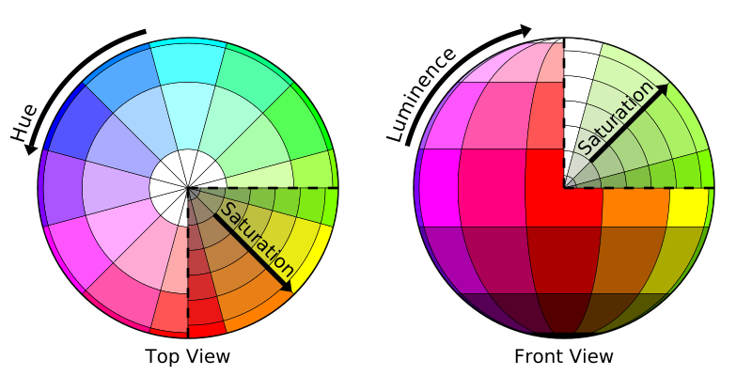
[ Color Space HSL ]

Slide 35
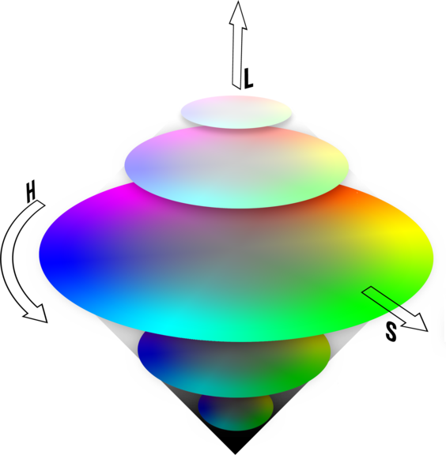
[ Color Space HSL ]

Slide 36
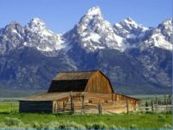
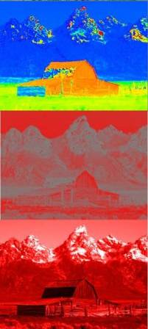
[ Color Space HSL ]
H
S
L

Slide 37
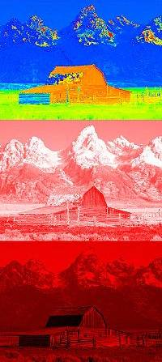
[ Color Space HSV ]
H
S
V

Slide 38
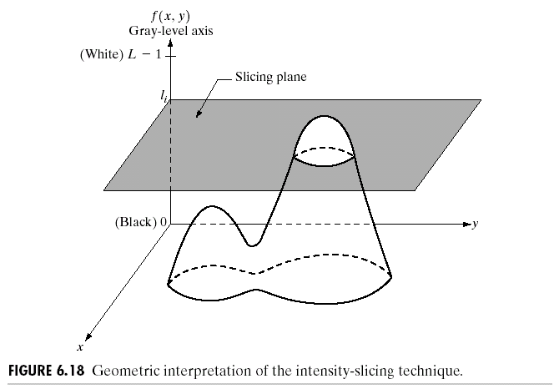
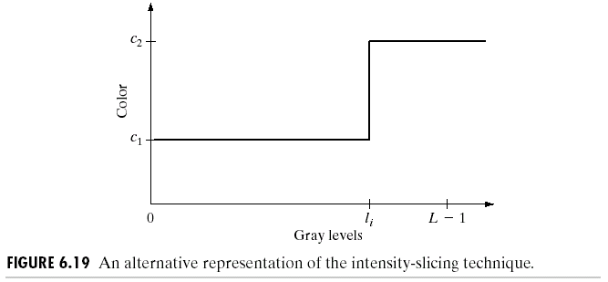
[ Pseudocolor ]
R. Gonzalez, R. Woods, S. Eddins (2009): Digital Image Processing Using MATLAB, 2nd edition. Gatesmark Publishing.

Slide 39
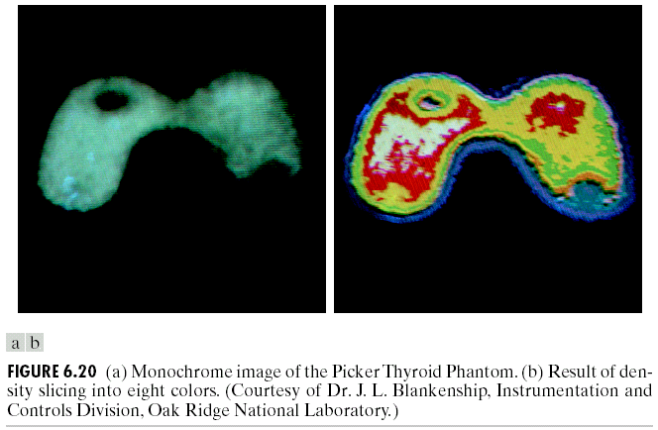
[ Pseudocolor ]
R. Gonzalez, R. Woods, S. Eddins (2009): Digital Image Processing Using MATLAB, 2nd edition. Gatesmark Publishing.

Slide 40
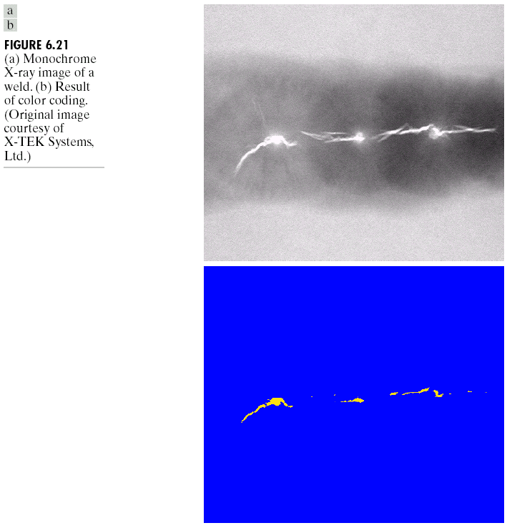
[ Pseudocolor ]
R. Gonzalez, R. Woods, S. Eddins (2009): Digital Image Processing Using MATLAB, 2nd edition. Gatesmark Publishing.

Slide 41
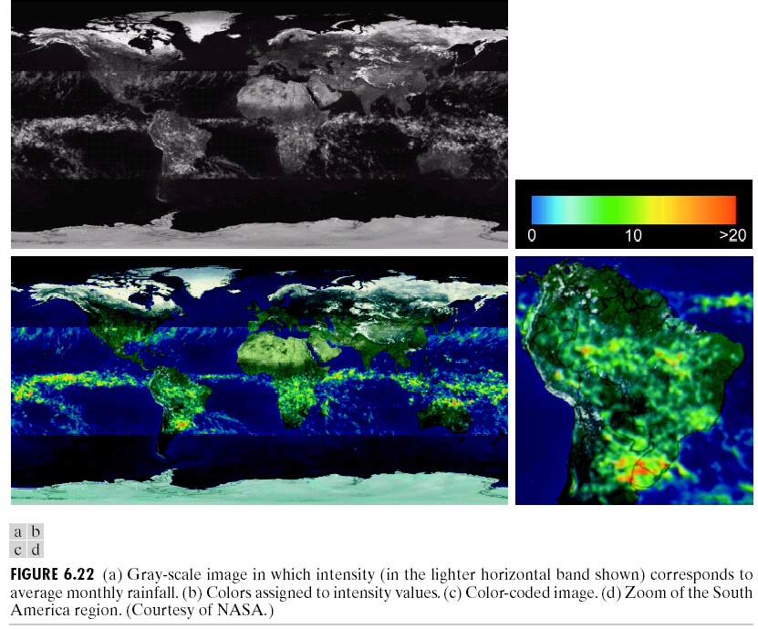
[ Pseudocolor ]
R. Gonzalez, R. Woods, S. Eddins (2009): Digital Image Processing Using MATLAB, 2nd edition. Gatesmark Publishing.

Slide 42
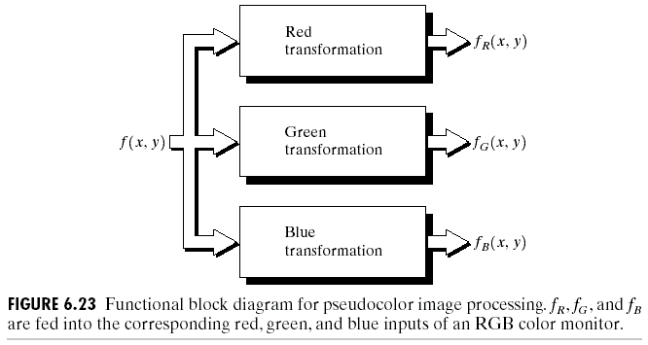
[ Pseudocolor ]
R. Gonzalez, R. Woods, S. Eddins (2009): Digital Image Processing Using MATLAB, 2nd edition. Gatesmark Publishing.

Slide 43
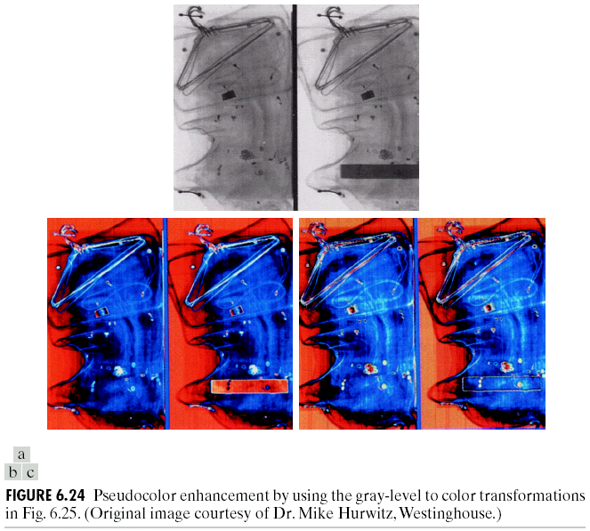
[ Pseudocolor ]
R. Gonzalez, R. Woods, S. Eddins (2009): Digital Image Processing Using MATLAB, 2nd edition. Gatesmark Publishing.

Slide 44
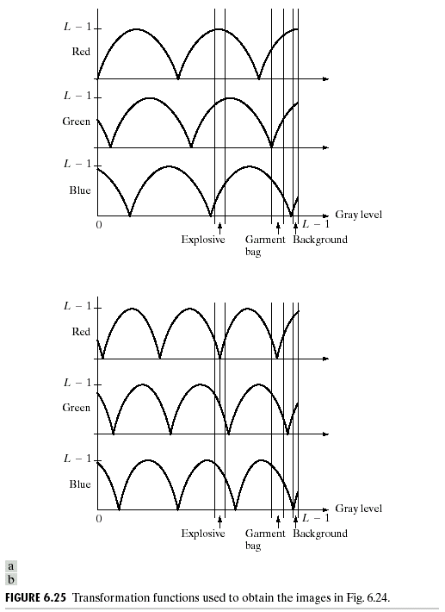
[ Pseudocolor ]
R. Gonzalez, R. Woods, S. Eddins (2009): Digital Image Processing Using MATLAB, 2nd edition. Gatesmark Publishing.

Slide 45
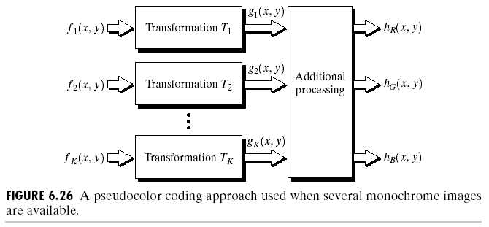
[ Pseudocolor ]
R. Gonzalez, R. Woods, S. Eddins (2009): Digital Image Processing Using MATLAB, 2nd edition. Gatesmark Publishing.

Slide 46
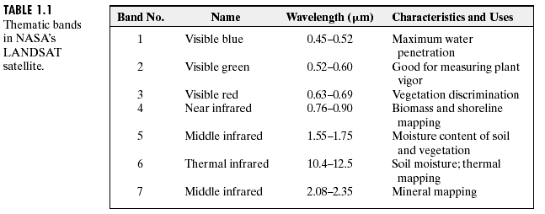
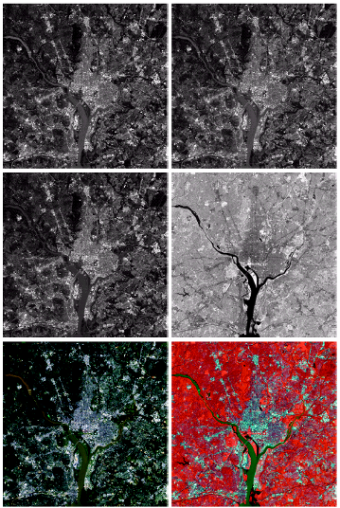
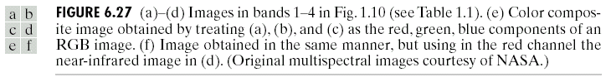
[ Pseudocolor ]
R. Gonzalez, R. Woods, S. Eddins (2009): Digital Image Processing Using MATLAB, 2nd edition. Gatesmark Publishing.

Slide 47
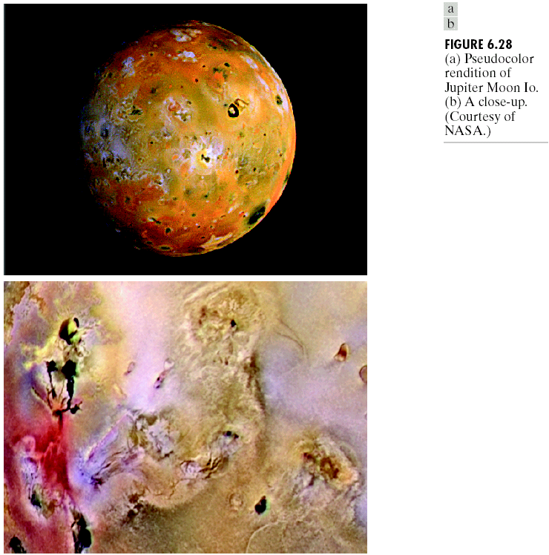
[ Pseudocolor ]

Slide 48
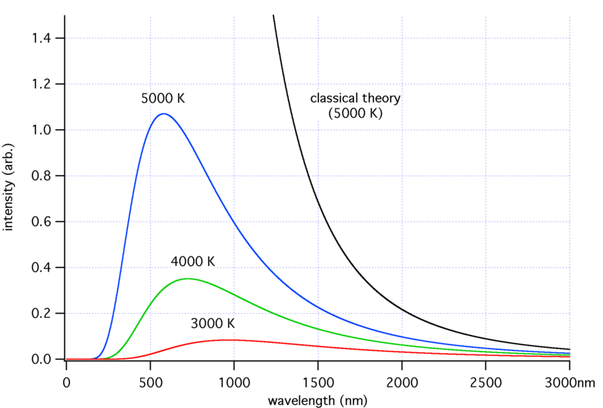
[ Temperature of Color ]

Slide 49
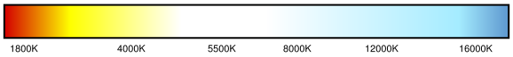

[ Temperature of Color ]

